Slide 1
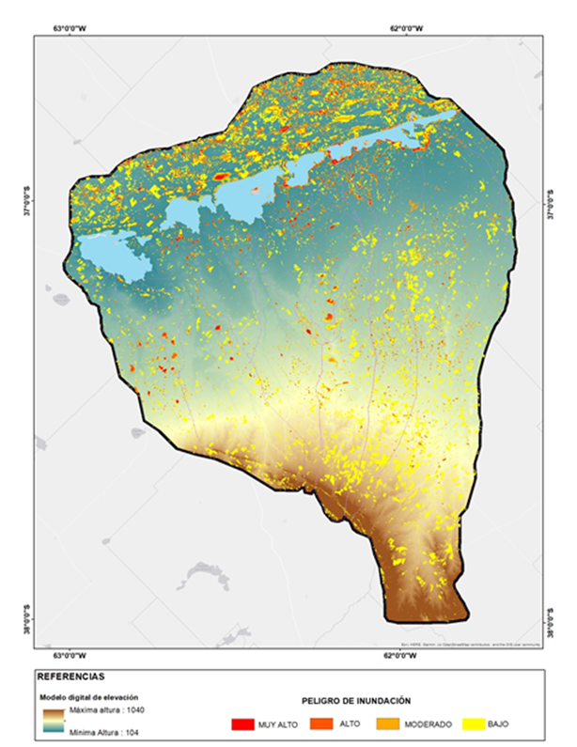
Environment Hazards, vulnerability and Risk
Floods: Implementation of integrated methodologies combining medium-resolution optical sensors and SAR imagery for the generation of flood risk models and maps.
Assessment of flood risk using a synergistic approach with Sentinel 1, Sentinel 2, and Landsat 5 and 8 data: a case study in an endorheic basin in the Pampas region, Argentina.

Slide 2
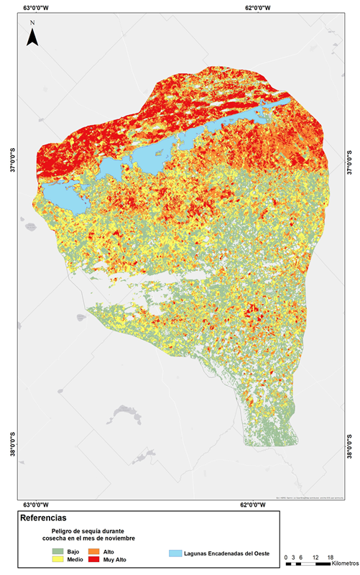
Environment Hazards, vulnerability and Risk
Drought: Implementation of Integrated Methodologies Combining Medium-Resolution Optical Indices, Specifically the TDVI, for Generating Water Stress Models and Drought Risk Maps.
The Temperature Vegetation Dryness Index (TVDI) shows surface moisture trends by combining EVI and LST data from Landsat 8.

Slide 3
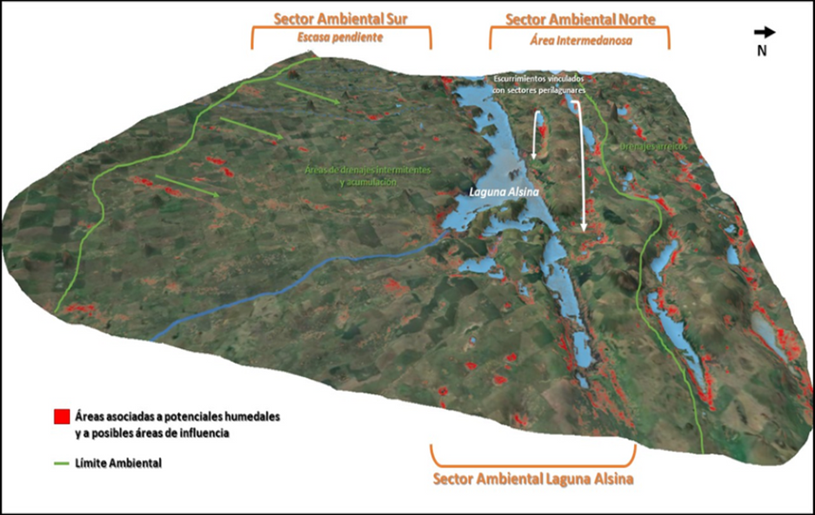
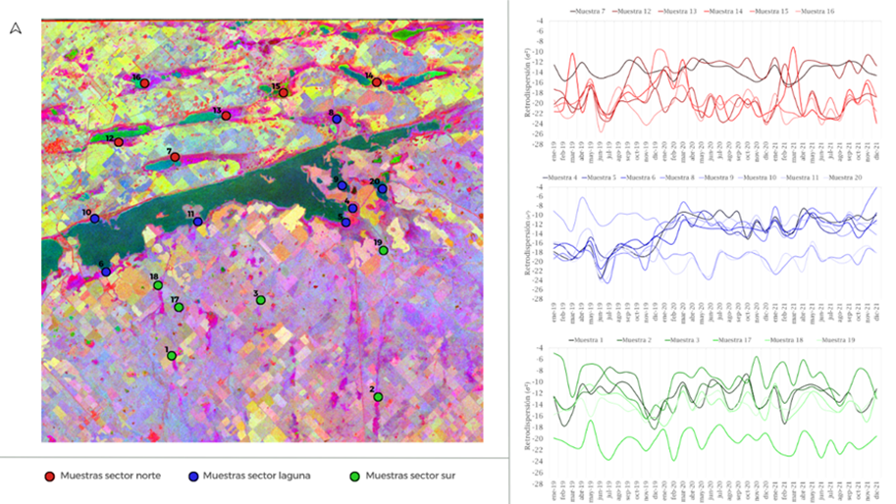
Environmental models
Developing environmental models through the synergy of optical and SAR imagery for studying shallow lakes, wetlands, threats, vulnerabilities, and environmental risks in Pampean environments.
A 3D environmental description model of Laguna Alsina was created using the Qgis2threejs plugin. This model integrates the ALOS PALSAR DEM, PCA time series from Sentinel 1 C, and water indices for the detection and identification of wetlands and hydraulic connectivity in a peri-lagoon environment

Slide 4
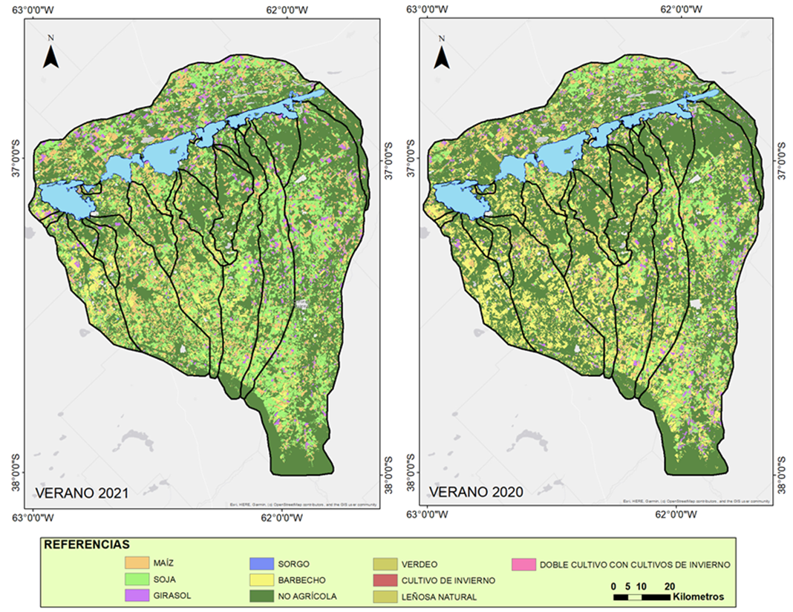
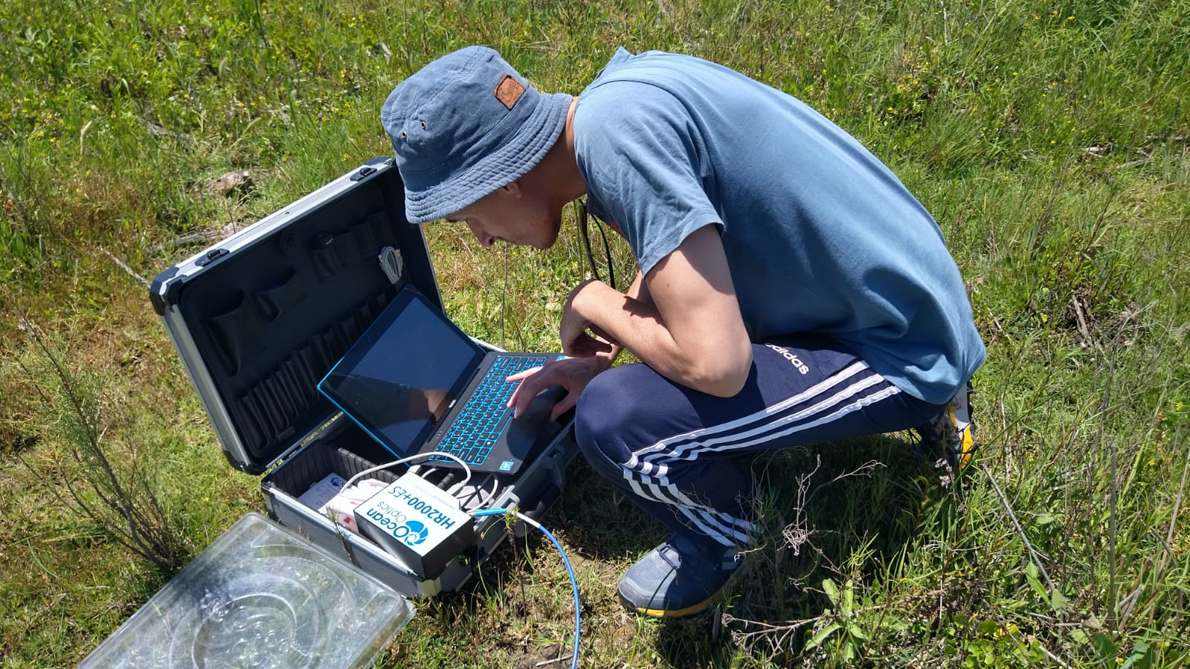
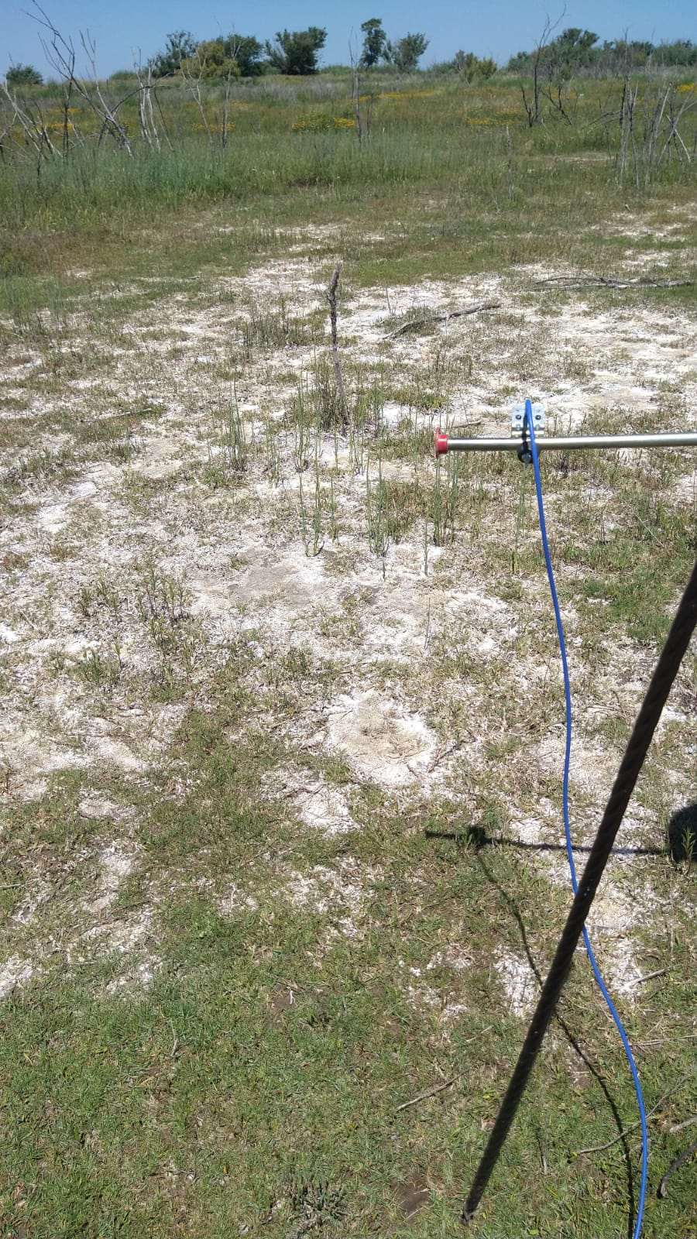
Field Spectroradiometry and crop maps
Development of crop maps using geographic information and Segment Anything Model (SAM) methodologies, incorporating control points and spectroradiometry, in collaboration with studies from INTA Barrow

